Slide 1
DSP Lab 1
Introduction

Slide 2
Practical details
Teaching assistants:
Brent De Weerdt - brent.de.weerdt@vub.be
Giannis Dilmperis - ioannis.dilmperis@vub.be
Our office: PL9 2nd floor

Slide 3
Practical details
6 Lab sessions on Wednesday 8-12 AM
Presence is not mandatory
No graded assignments
Solutions will be uploaded on the next week
Evaluation:
Lab exam in January accounting for ~30% of the DSP grade
The exam will be a live coding exam with similar exercises to the lab

Slide 4
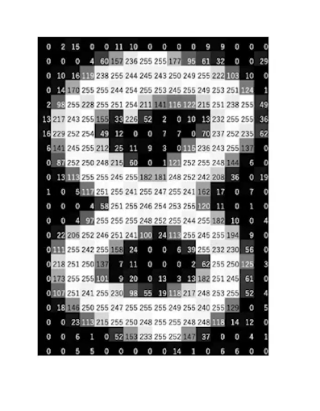
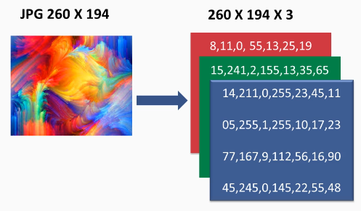


Discrete signals
1D signals
$$x\left[n\right]={\left[x\left[1\right] x\left[2\right] … x\left[N\right]\right]}^{T}$$
2D signals (grayscale image) 3D signals (RGB image)
$N$ samples

Slide 5
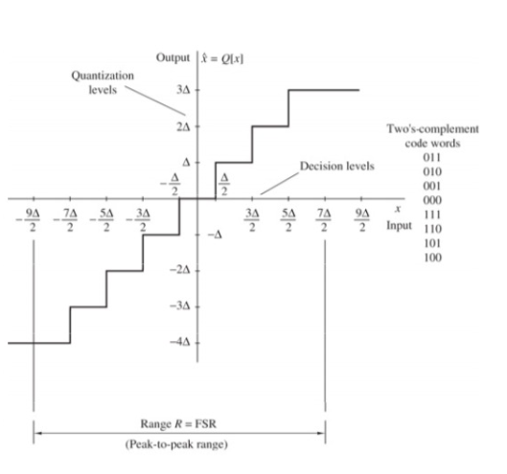
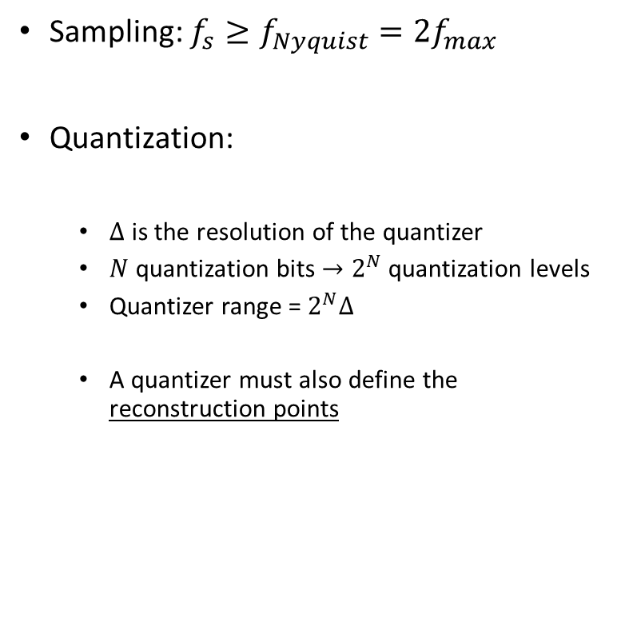
Sampling and Quantization
Sampling: $f_{s}≥f_{Nyquist}=2f_{max}$
Quantization:
$Δ$ is the resolution of the quantizer
$N$ quantization bits $→2^{N}$ quantization levels
Quantizer range = $2^{N}Δ$
A quantizer must also define the reconstruction points

Slide 6
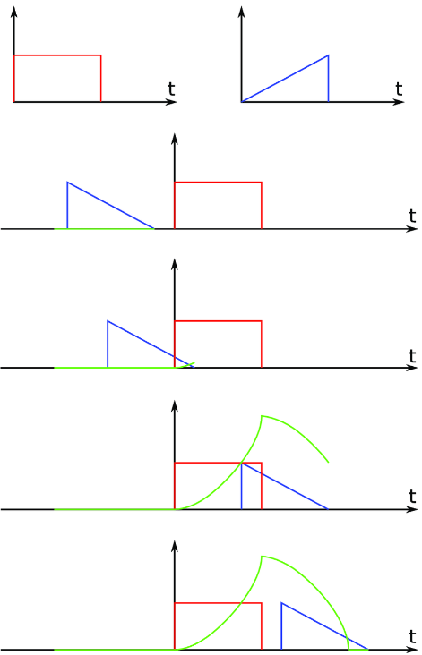











Linear Convolution
Continuous time:
$$g\left(t\right)=\left(f∗g\right)\left(t\right)= \int_{−∞}^{+∞}{f\left(τ\right)h\left(t−τ\right) dτ}$$
Discrete time:
$$y\left[n\right]=x\left[n\right]∗h\left[n\right]=\sum_{k}^{ }{x\left[n−k\right]h[k]}$$
padding
Original signal $x$
padding
$$x$$
0
0
0
0
$$×$$
$$×$$
$$×$$
$$h$$
$$h_{3}$$
$$h_{2}$$
$$h_{1}$$
$$Σ$$
$$y$$

Slide 7

Linear Convolution
Assume $N$ samples for $x$ and $L$ samples for the filter $h$ ($L$ odd, $L<N$)
What is the size of the output $y$ ?
a) $N+L−1$ b)$N$ c)$N−L+1$

Slide 8
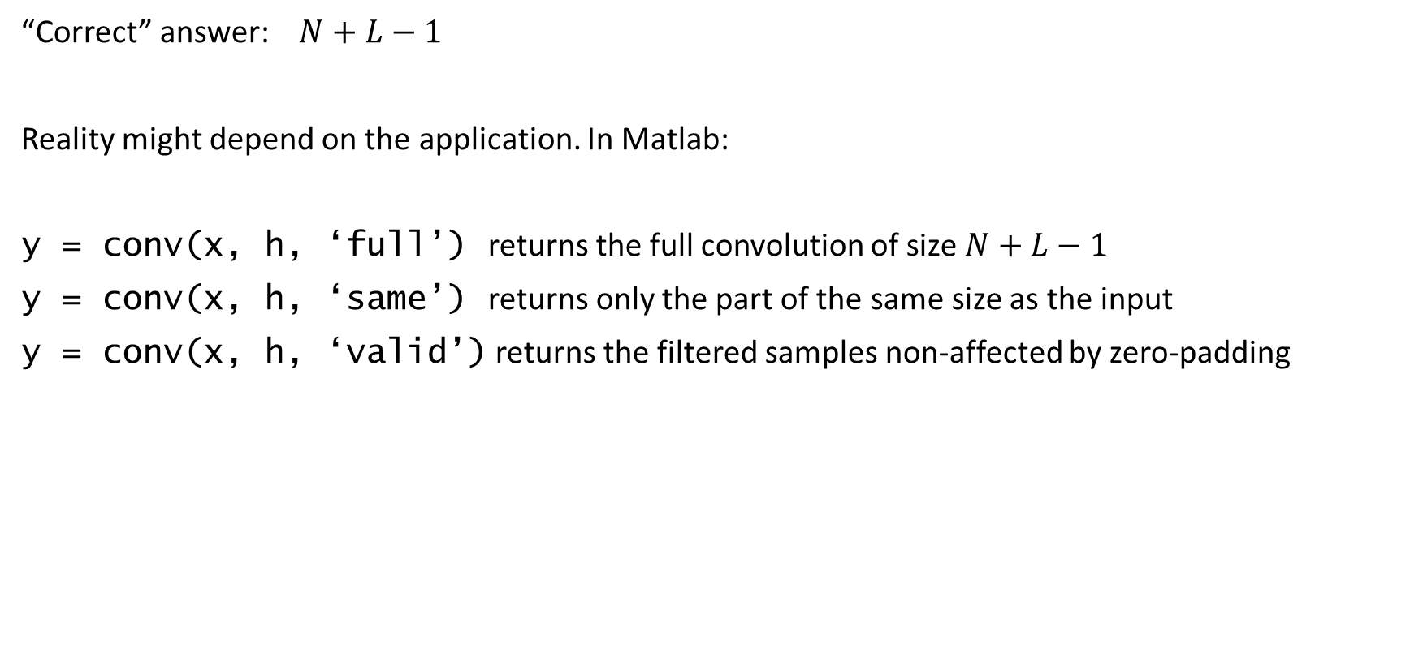
Linear Convolution
“Correct” answer:$N+L−1$
Reality might depend on the application. In Matlab:
y = conv(x, h, ‘full’) returns the full convolution of size $N+L−1$
y = conv(x, h, ‘same’) returns only the part of the same size as the input
y = conv(x, h, ‘valid’) returns the filtered samples non-affected by zero-padding

